Slide 1

Presented by
Vikas Chandra

Slide 2


Slide 3
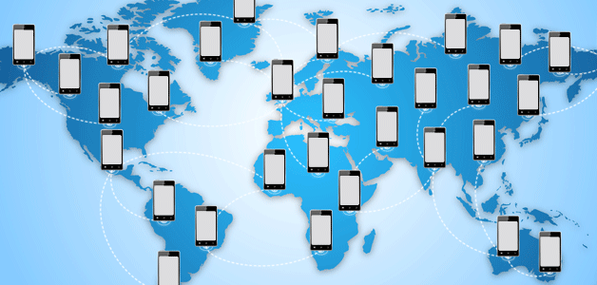

Slide 4
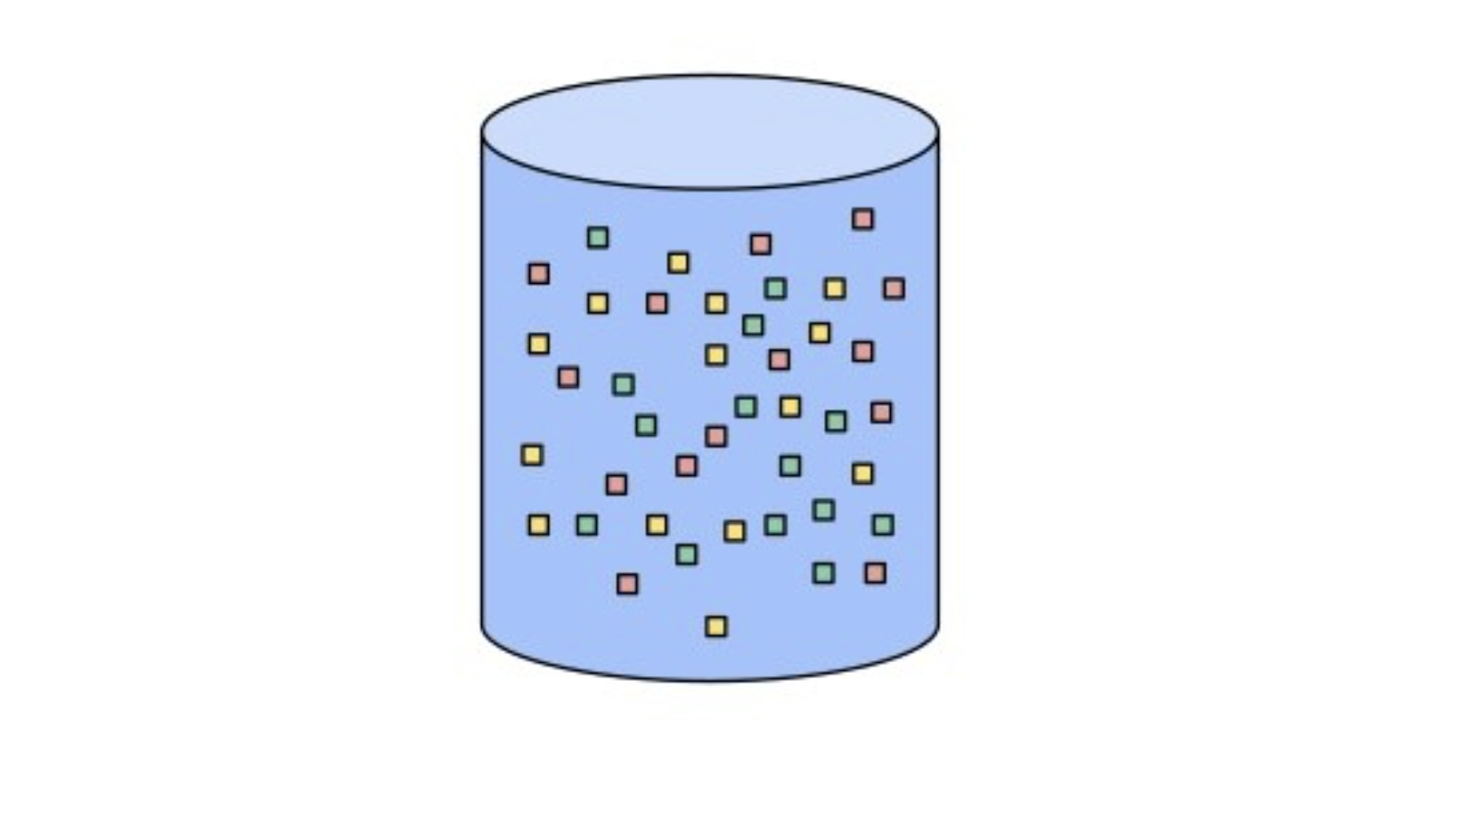
Data

Slide 5
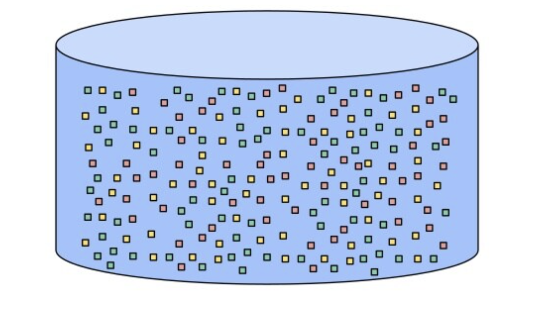
BIGData

Slide 6
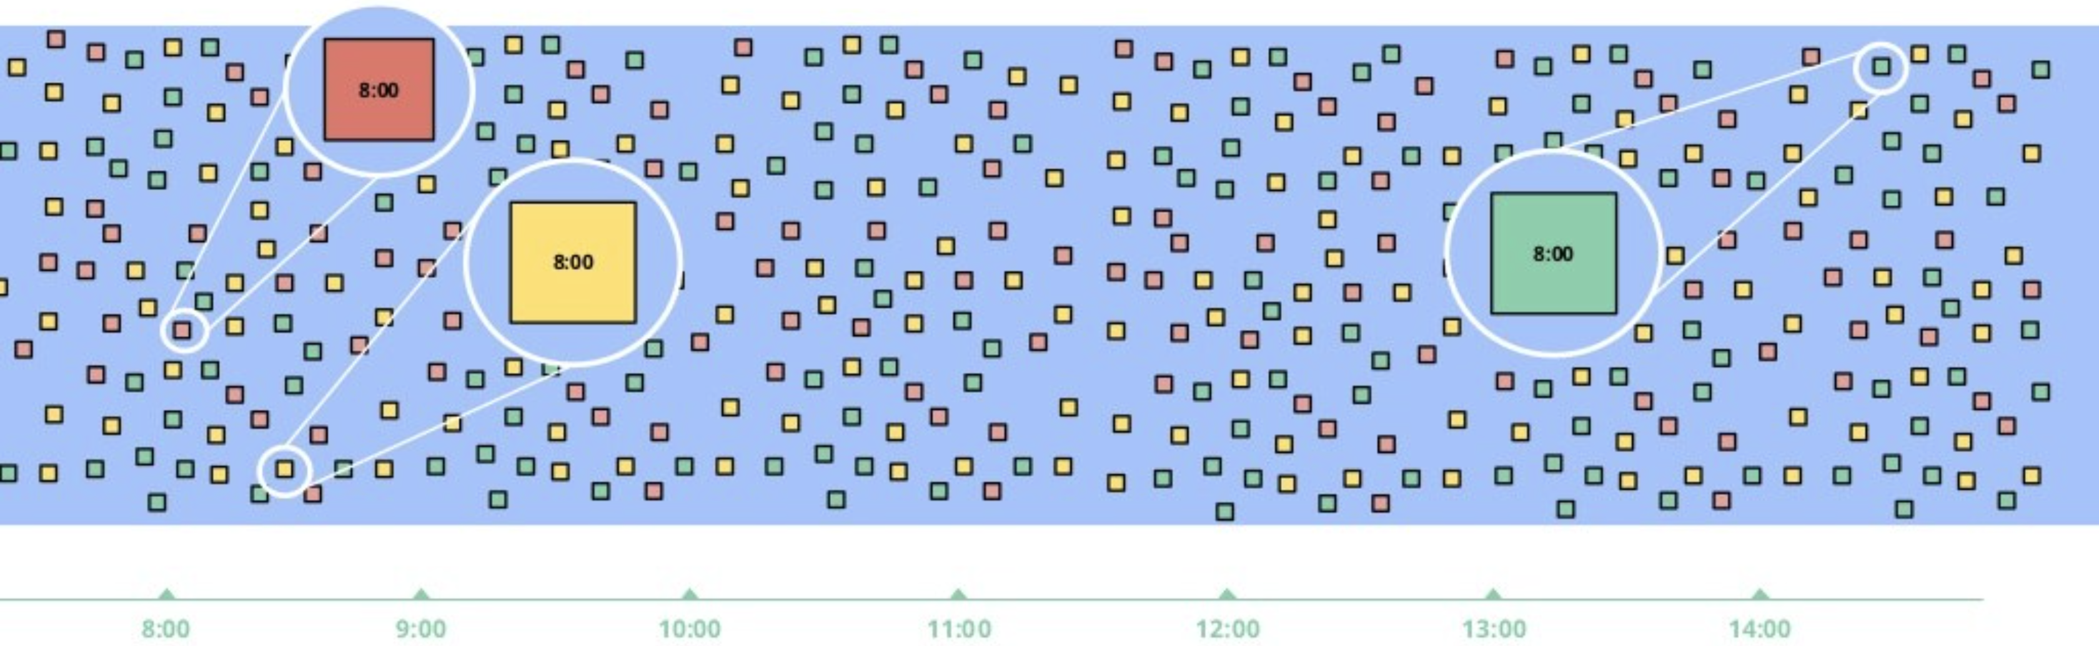
DELAYS

Slide 7

Delay

Slide 8
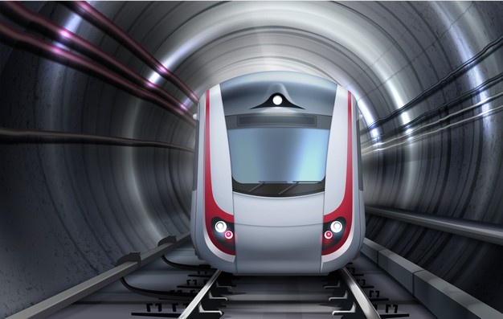




Slide 9
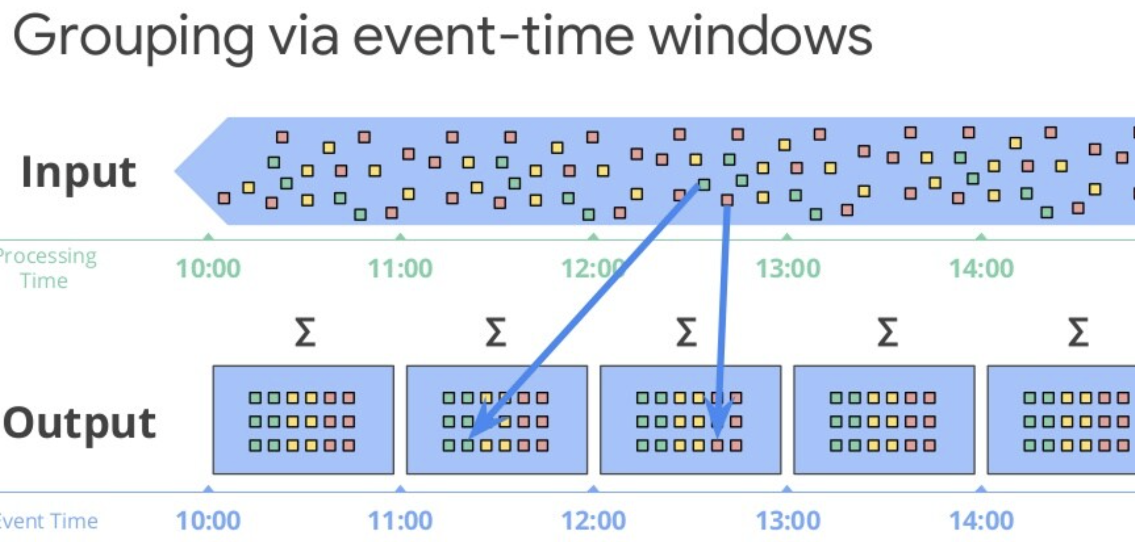

Slide 10
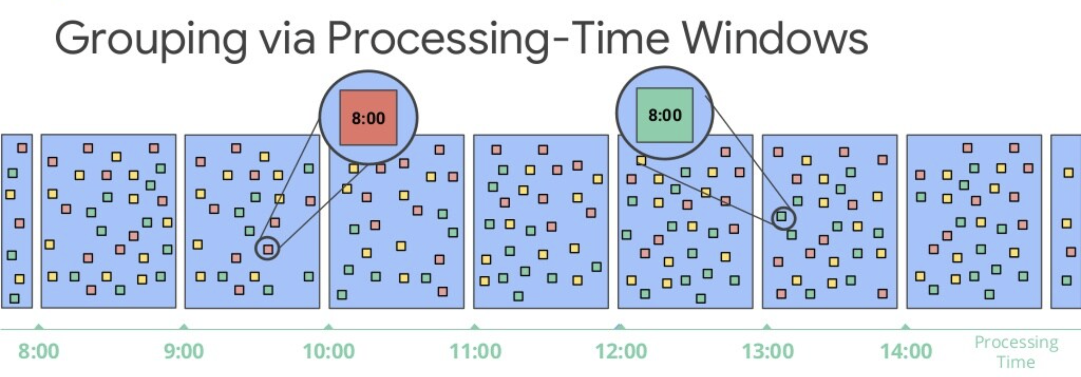

Slide 11
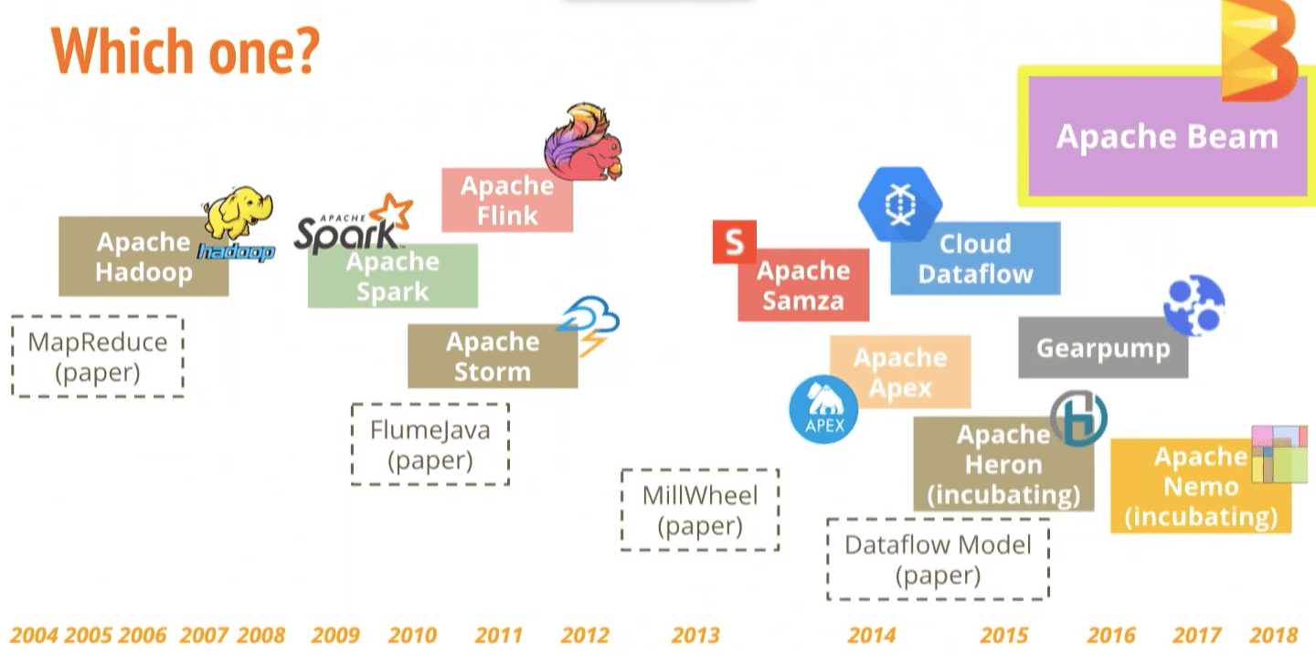

Slide 12
APACHE BATCH STREAM

Slide 13
Apache BEAM is Unified processing model for expressing efficient and portable data processing pipelines

Slide 14






Pipeline
Input Data
Read
Input Data
Transform Data
Dump output Data
PCollection
PTransform

Slide 15
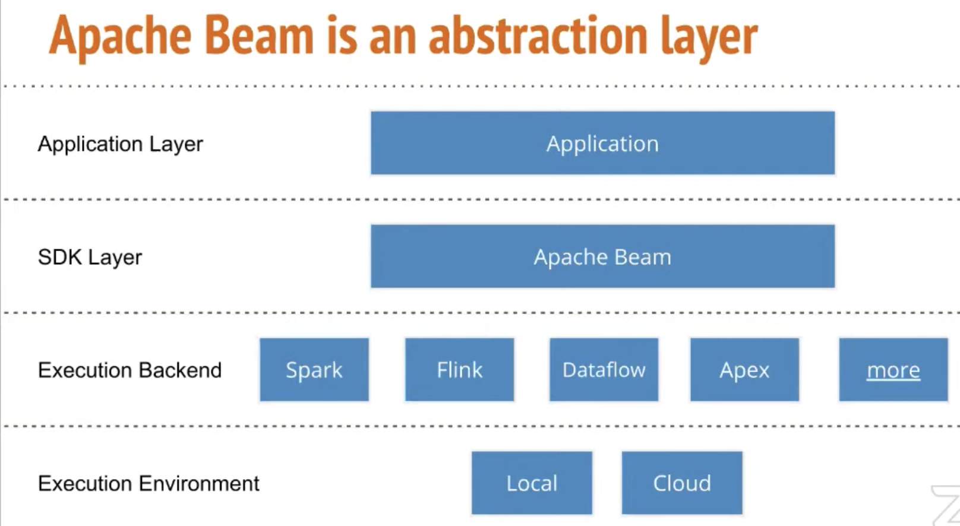


Slide 16
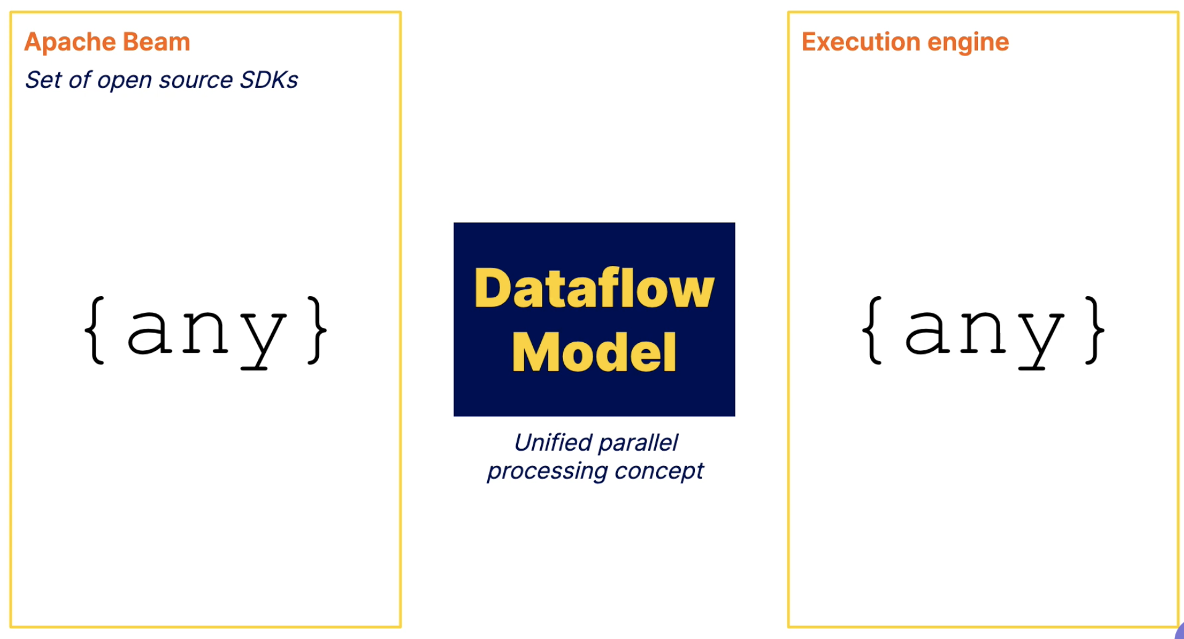

Slide 17
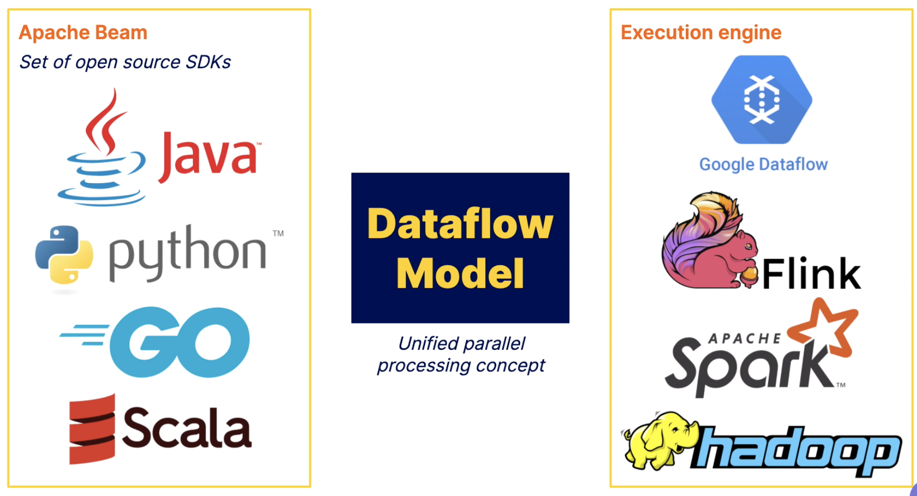

Slide 18
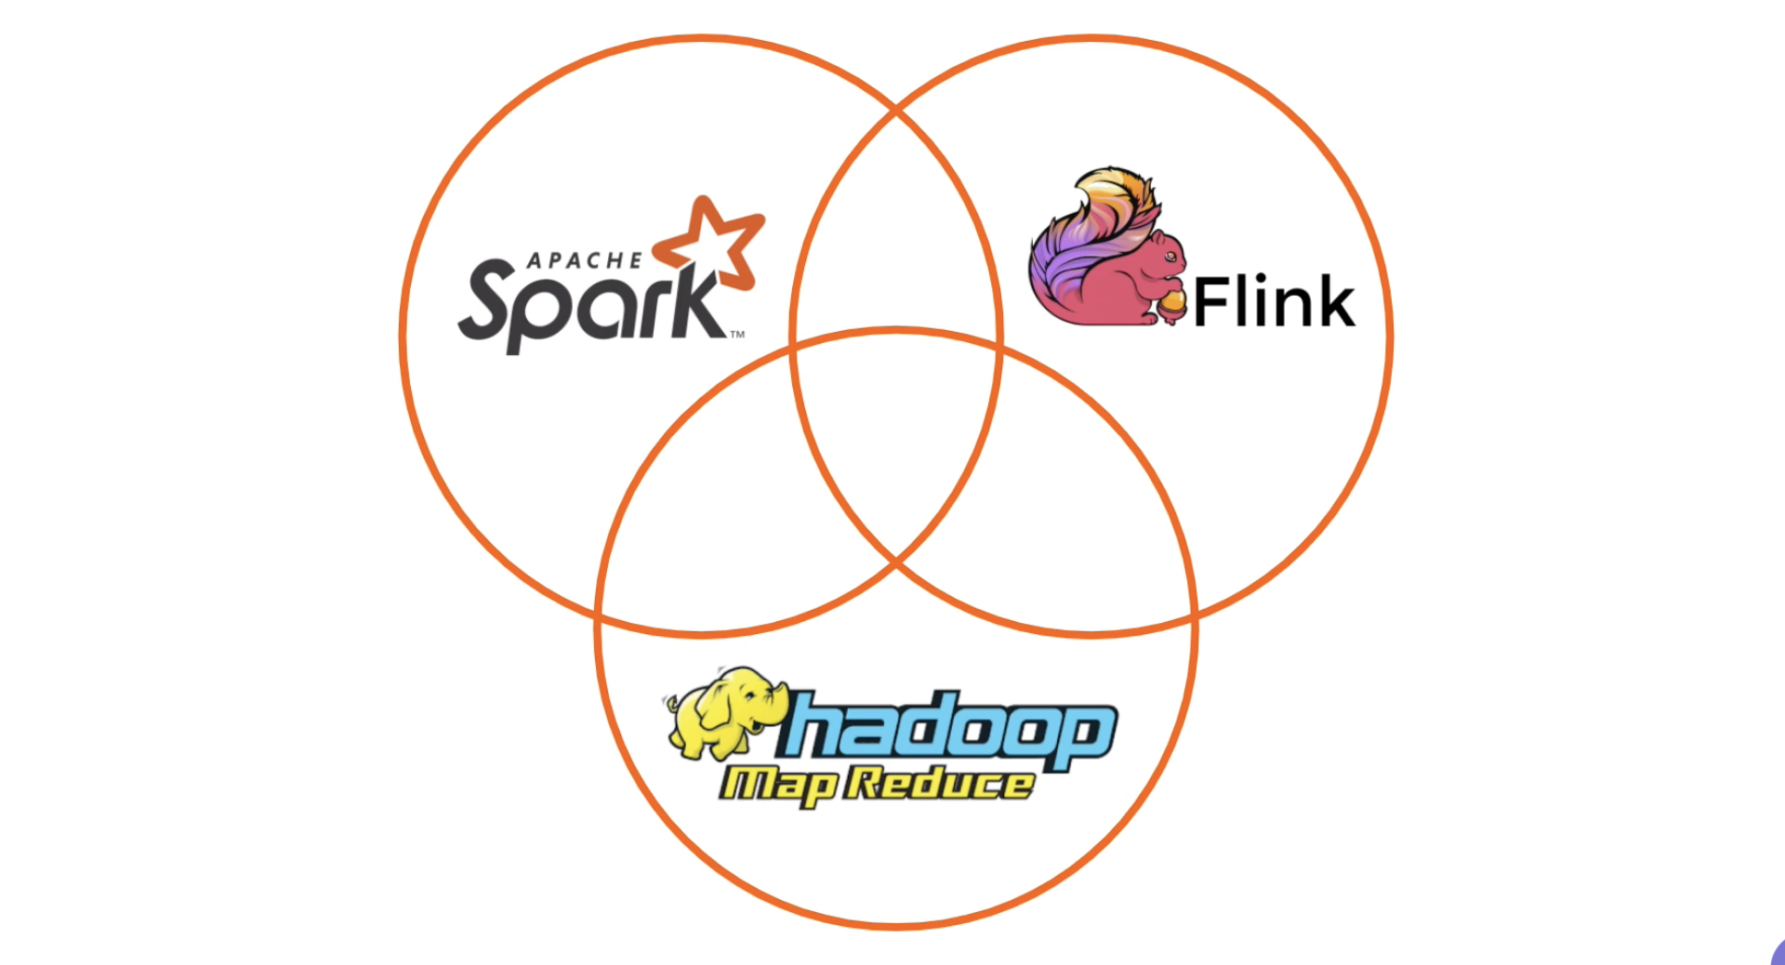

Slide 19
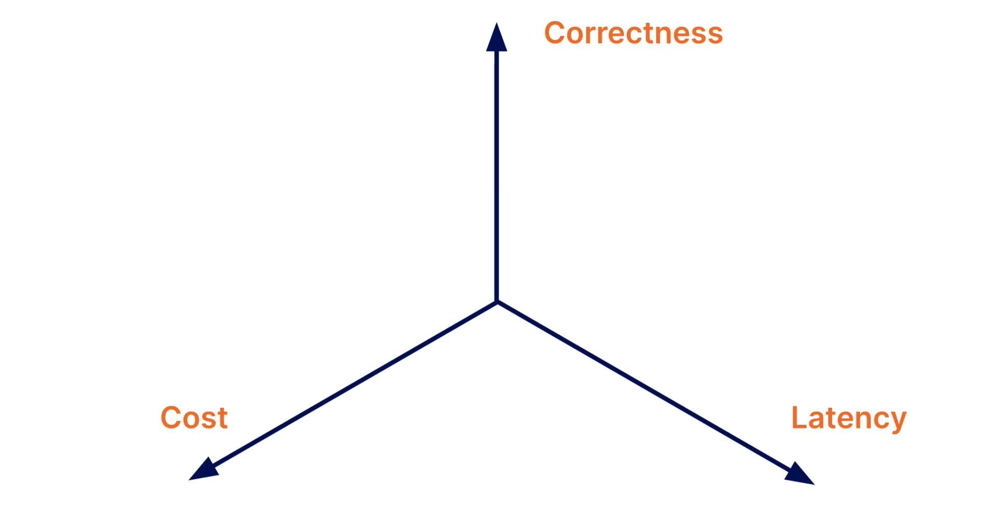

Slide 20
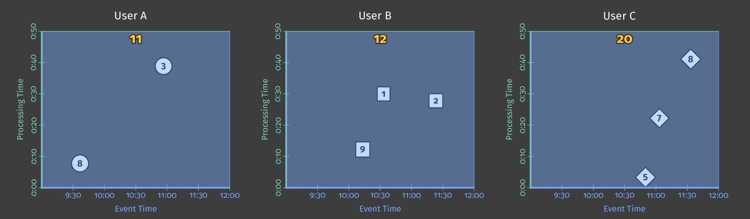
Score data for three users

Slide 21
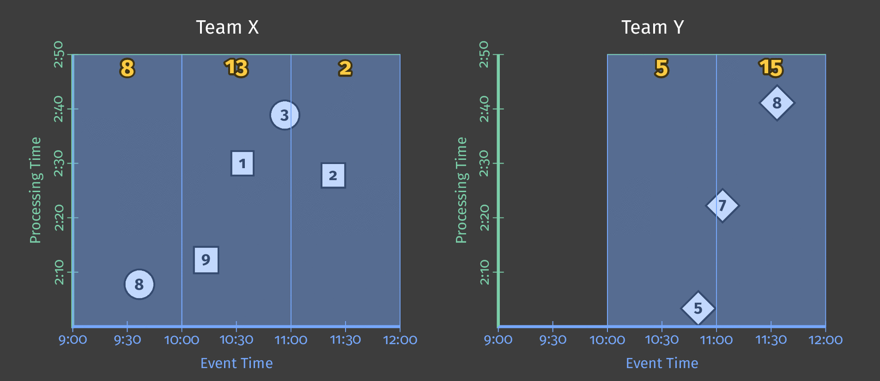
Fixed-Time Windowing

Slide 22
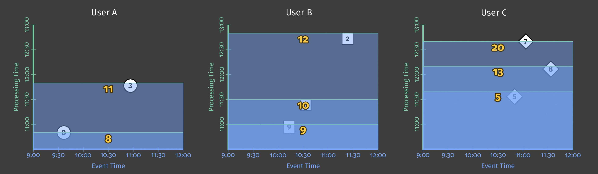
User Score based on Processing Time

Slide 23
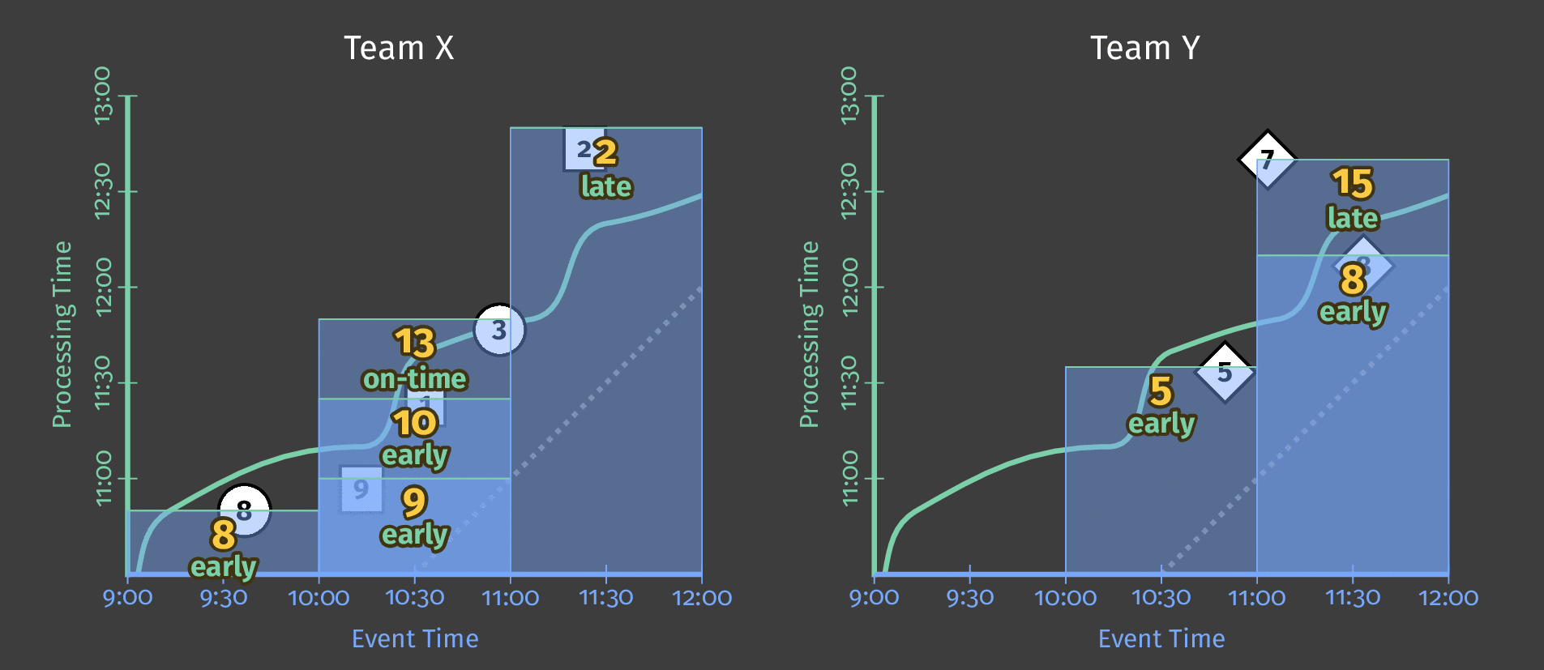
Team Score based on Event Time

Slide 24
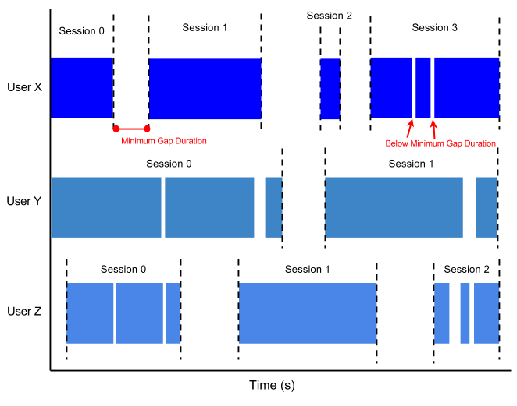
User sessions with a minimum gap duration

Slide 25
Key WORDS
Pipeline
Pcollection
PTransform
Create ➔ Pipeline ➔ PCollection
Apply ➔ PTransform
Run ➔ Runners

Slide 26


Slide 27
References
https://beam.apache.org/get-started/mobile-gaming-example/
https://www.youtube.com/watch?v=waAwmY8xrgQ
https://www.youtube.com/watch?v=-6xpDRiurmA
https://www.youtube.com/watch?v=lbY85HRZrGI

